Slide 1
Script Buddy
Group 2: Hailey Vadnais, Matthew Kotras, Sebastian Vang, Stephen Behnke

Slide 2
Product Description
Our product is software that makes it easy to make scripts in AutoHotKey, a scripting language. AutoHotkey is a custom scripting language for Microsoft Windows which provides keyboard shortcuts, macro creation, and software automation to automate repetitive tasks in Windows applications.
Our target audience is anyone who has work that requires doing repetitive tasks on computers, but who are not great with computers.

Slide 3
Product Rationale
The problem we set out to solve is that people with low levels of computer experience are intimidated by scripting and so they never get to experience the power of AutoHotKey in their daily lives. Our product solves this problem by turning scripting into a task that’s as easy to do as clicking a button.

Slide 4
User Stories
As a teacher, so that I can answer questions emails quickly, I want to create scripts that automatically generate emails for frequently asked questions.
Story Point(s): 1
As a student, so that I can easily get to work, I want to create scripts that set up the application I use for work.
Story Point(s): 1

Slide 5
User Stories
As a student, so that I can type common words quickly, I want to create hotstrings that automatically expand acronyms into their full text
Story Point(s): 1
As a music enjoyer, so that I can change my music easier, I want to control my music with simple hotkeys.
Story Point(s): 1

Slide 6
User Stories
As a user with many scripts, so that I can manage what scripts I use at any given time, I want to have a panel for starting, stopping, modifying, and deleting any scripts from within the application.
Story Point(s): 2
As a general user, so that I can use the scripts I have created, I want to be able to run scripts from the application or export them as an AHK file.
Story Point(s): 3

Slide 7
User Stories
As a gamer, so that I can have an advantage in-game, I want to create macros where I can save mouse movements and keyboard inputs occurring at specific rates/times/intervals.
Story Point(s): 3
As a programmer, so that I can save and access my progress for any script from any computer, I want to be able to upload my scripts to a database.
Story Point(s): 3

Slide 8
User Stories
As a helpful programmer, so that I can share my work with other people, I want to make my scripts accessible to the community through a community accessible list of scripts.
Story Point(s): 1
As an inexperienced user, so that I can get complicated functionality that I cannot program myself, I want to be able to search for scripts from the community by name.
Story Point(s): 1

Slide 9
User Stories
As a more advanced user, so that I can write more advanced scripts, I want to be able to execute some of my script conditionally, such as if a window is currently open, or if the computer has low battery.
Story Point(s): 2
As a programmer, so that I can upload scripts to the database, I want to be able to create an account and to login to view my community contributions
Story Point(s): 3

Slide 10
User Stories
As a programmer, so that I can keep my workstation secure, I want to be able to logout of my account.
Story Point(s): 1
As a programmer, so that I can have rights to the scripts I have uploaded, I want to be able to edit and remove them from the database
Story Point(s): 1

Slide 11
Proposed Technical Setup
Our team will implement this project in .NET using a MySQL database and WPF.

Slide 12
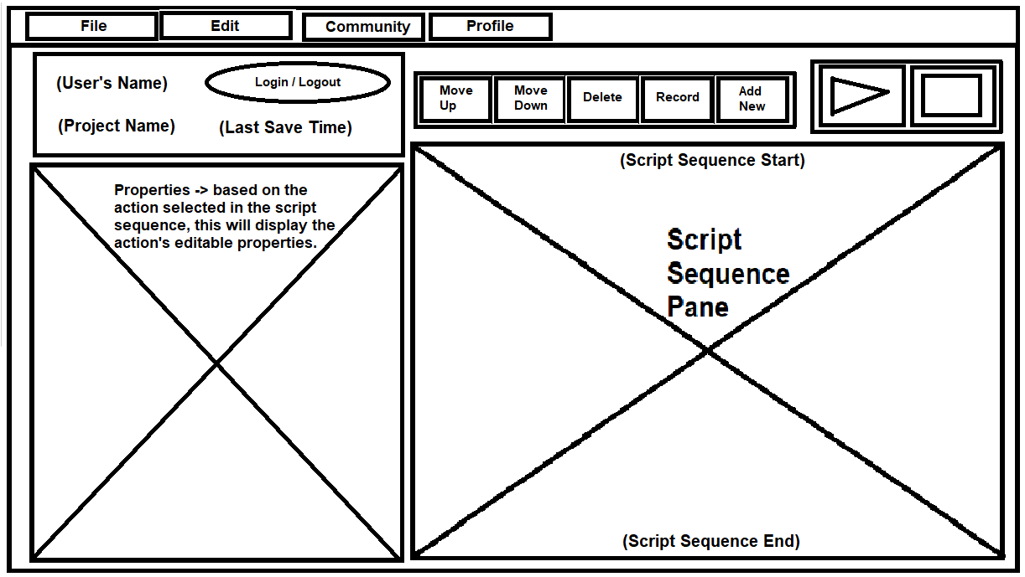
User-Interface
Window Name: Main Menu
Description:
This is the main menu. It is what opens when first starting the program.
From this menu users can find access to all function/windows required to use this program.

Slide 13
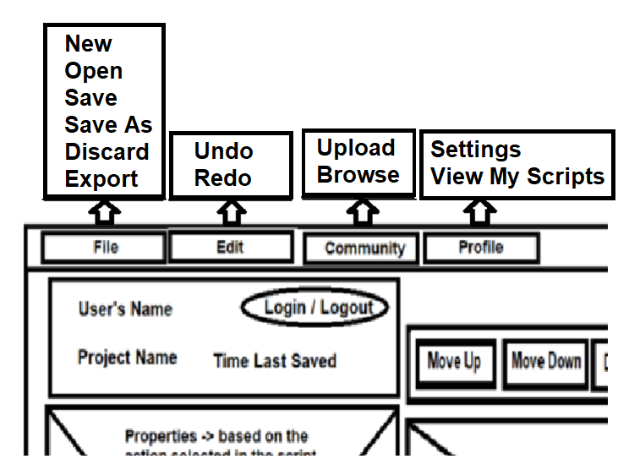
User-Interface
Window Name:
Main Menu (Continued…)
Description:
This is a sequence of windows from the drop-down menus.

Slide 14
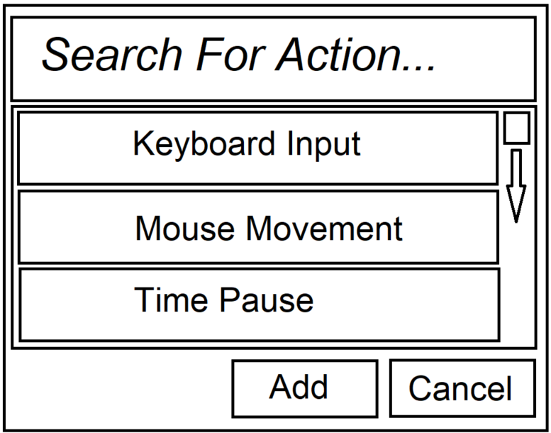
User-Interface
Window Name: Add Action Menu
Description:
The user can search for actions in the shown list.
The list is full of various actions like keyboard presses, mouse actions, pauses, etc.
Upon the user selecting “Add New”, they can add a new action to the current sequence

Slide 15
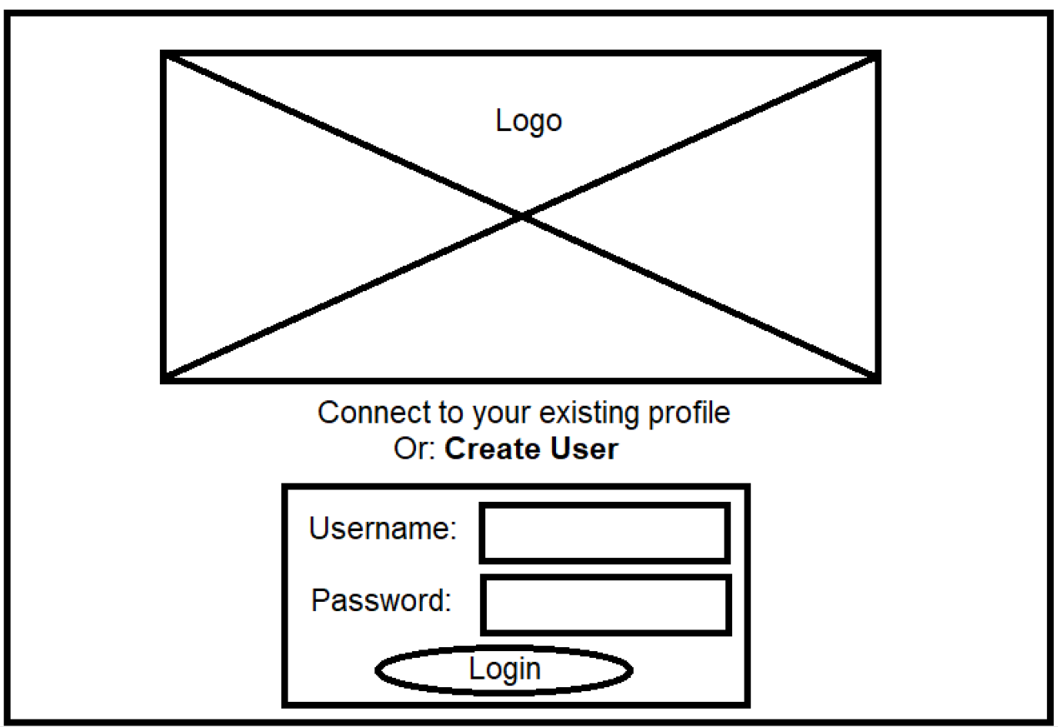
User-Interface
Window Name: Login
Description:
This is the login popup window. From here users will be able to enter their username and password and login to their profile.
They can also select to create a new user.

Slide 16
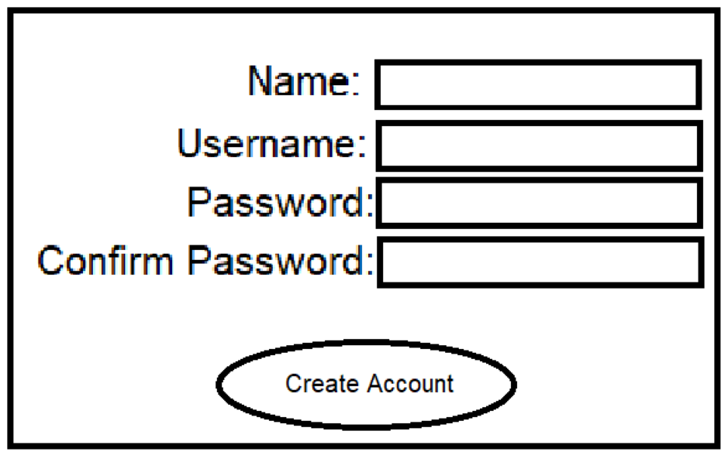
User-Interface
Window Name: Create Account
Description:
This is the create account popup window.
In this window users will be able to make a new account.

Slide 17
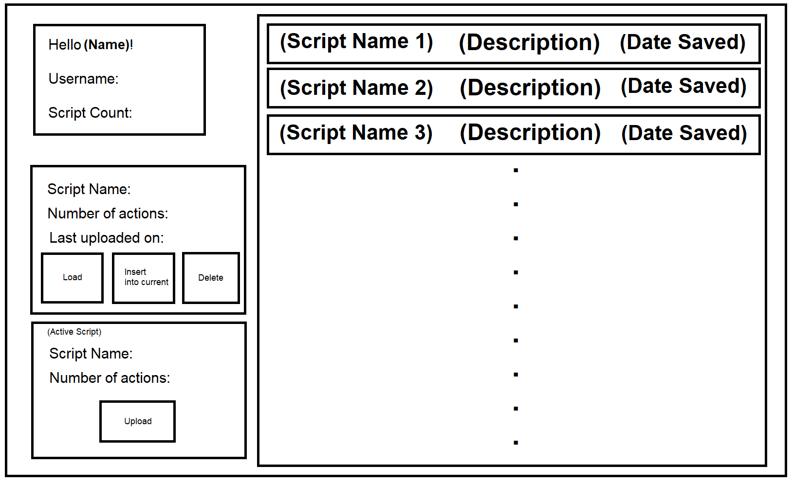
User-Interface
Window Name: View Scripts Menu
Description:
This menu will show the current user’s scripts, which, when selected, will show information related to the script.
From here the user can insert this script into their current script, load the script, or delete the script.
The user can also upload their current local save into this list of database scripts. This menu will also show community posted scripts.

Slide 18
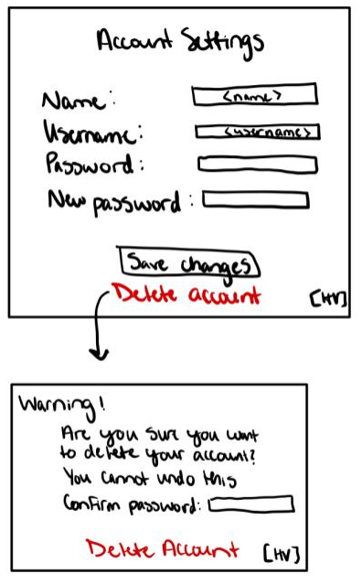
User- Interface
Window Name: Account Settings
Description:
If a user is logged in, they can change their name, username, or password
Account deletion will trigger a warning window that has the user confirm password one last time

Slide 19
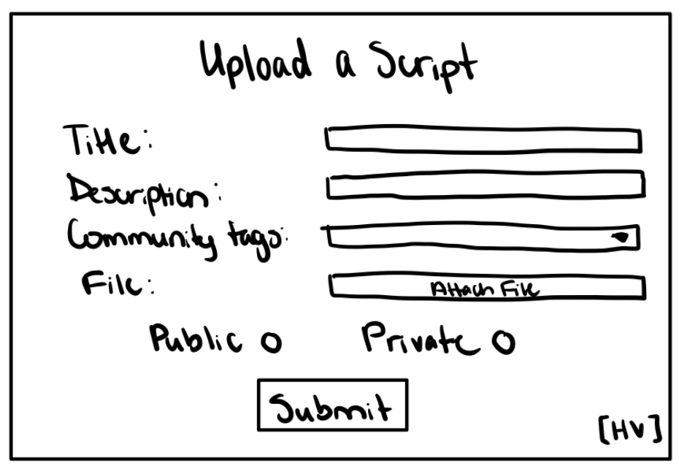
User-Interface
Window Name: Upload Scripts
Description:
Upload script file to the community tab
Assign a title, description, and community tags
Public or private access to uploads

Slide 20
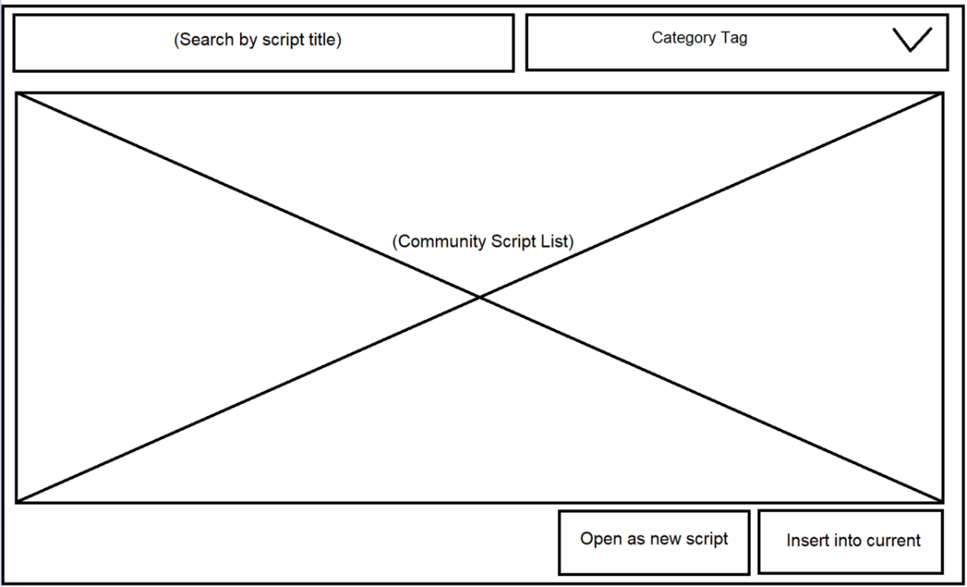
User-Interface
Window Name: Community Scripts Menu
Description:
Browse public scripts from other users
Search by title or sort by tags
Download and use script in a new or existing file

Slide 21
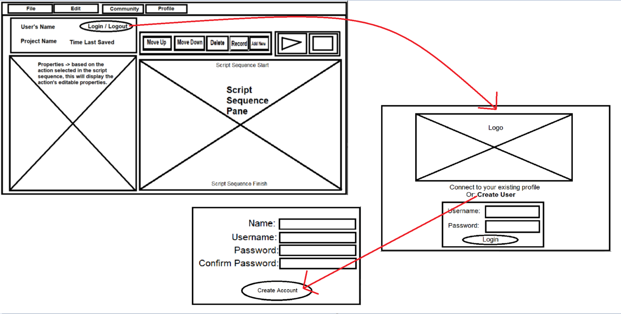
Window Sequence

Slide 22
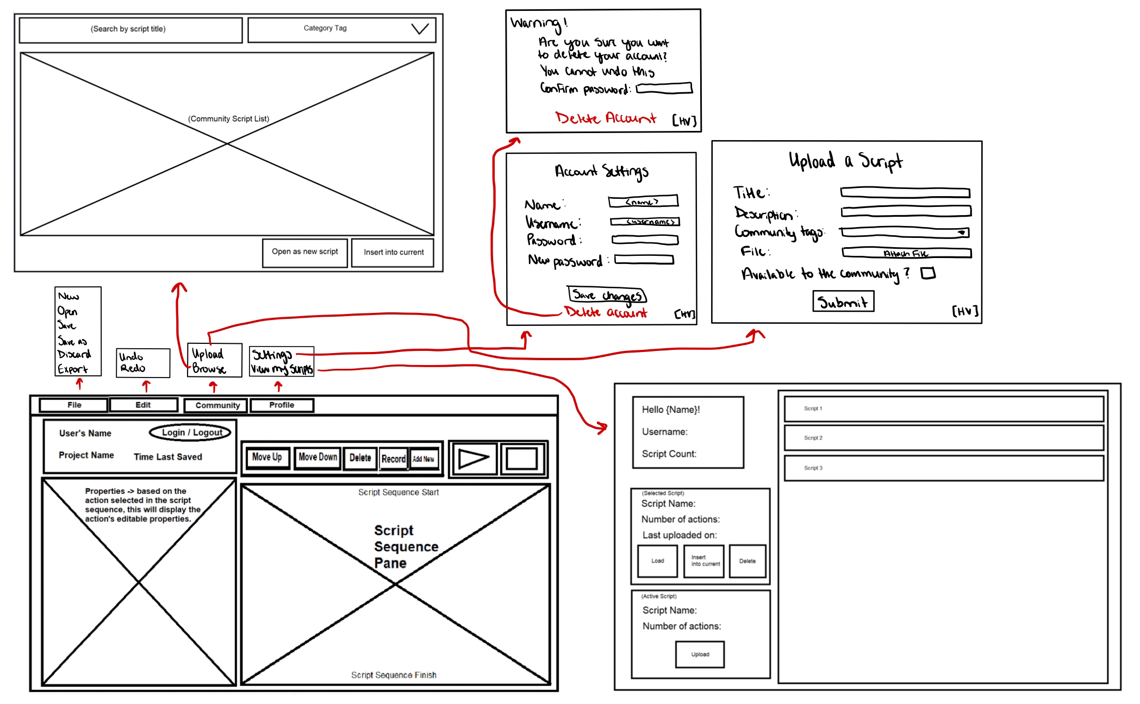
Window Sequence

